Slide 1




AT82.02
Data Modeling and Management
Lab7: Columnar Database

Slide 2
Outline
Introduction
RDB vs. Columnar Database
Apache Cassandra
Key Features
Data Model Design
Data Manipulation
Aggregation Function
Cassandra CQL Collections
Notes:
Partition Keys, Compound keys, Clustering keys, Composite keys

Slide 3
RDB vs. Columnar Database
Row oriented databases are databases that organize data by record such as, Postgres, MySQL
Firstname | Lastname | Address
John | Smith | AIT
Peter | Parker | AIT
Row 1
Row 2
John | Smith | AIT | Peter | Parker | AIT

Slide 4
RDB vs. Columnar Database
Column oriented databases are databases that organize data by field. Columnar databases provide performance advantages to querying data for reading and computing on columns efficiently such as, Apache Cassandra, BigQuery, HBase
Column 1
Column 2
Column 3
Firstname | Lastname | Address
John | Smith | AIT
Peter | Parker | AIT

Slide 5
Why Columns not Row?
Row Oriented Database
Table of Data
Column Oriented Database
date | price | size
2020-01-15 | 10.2 | 10
2019-01-16 | 10.5 | 20
2019-01-17 | 10.1 | 40
2019-01-18 | 9.8 | 50
2019-01-19 | 10.2 | 12
… | … | …
2020-01-01 | 11.5 | 10
date | price | size
2020-01-15 | 10.2 | 10
2019-01-16 | 10.5 | 20
2019-01-17 | 10.1 | 40
2019-01-18 | 9.8 | 50
2019-01-19 | 10.2 | 12
… | … | …
2020-01-01 | 11.5 | 10
date | price | size
2020-01-15 | 10.2 | 10
2019-01-16 | 10.5 | 20
2019-01-17 | 10.1 | 40
2019-01-18 | 9.8 | 50
2019-01-19 | 10.2 | 12
… | … | …
2020-01-01 | 11.5 | 10
Notes:
In this slide I show the example why we need columnar DB.
Suppose we would like to perform a query like "average price" for all dates.
In row-oriented databases we have to read over the large areas, but in column-oriented databases the prices are stored as one sequential region and we can read just that region.
In summary, Column-oriented databases are extremely quick at aggregate queries (sum, average, min, max, etc.).
http://www.timestored.com/time-series-data/what-is-a-column-oriented-database

Slide 6
Column-Oriented DB vs Row-Oriented DB
Operation | Column-Oriented DB | Row-Oriented DB
Aggregate Calculation of Single Column e.g. sum(price) | Fast | Slow
Compression | Higher. It stores similar data together | -
Retrieval of a few columns from a table with many columns | Faster | has to skip over unnecessary data
Insertion/Updating of single new record | Slow | Fast
Retrieval of a single record | Slow | Fast
In summary, Column-Oriented DB is not suitable to operate with transaction data, it good at aggregate queries
Notes:
Column-Oriented DB is good for Aggregate Calculation very fast, Data compression is Higher , Retrieval of a few column also Faster.
But Insertion/Updating/Retrieval of a single record are slower than Row-Oriented DB
So, it not suitable to operate with transaction data

Slide 7

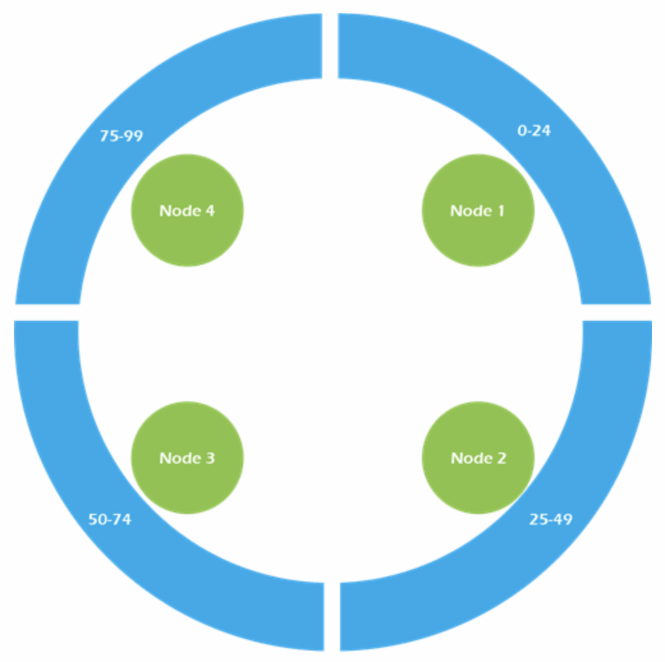
Apache Cassandra
Cassandra is a column-oriented database.
Masterless Architecture
Linear Scale Performance
No Single point of failure
Fault Detection and Recovery
Flexible and Dynamic Data Model
Data Compression
Cassandra Query language
Cassandra cluster
Notes:
Cassandra is a popular column-oriented databaseused to handle large amount of data .
It is a hybrid of column-oriented and key–value store database.
It is designed to store and manage large volumes of data without any failure.

Slide 8
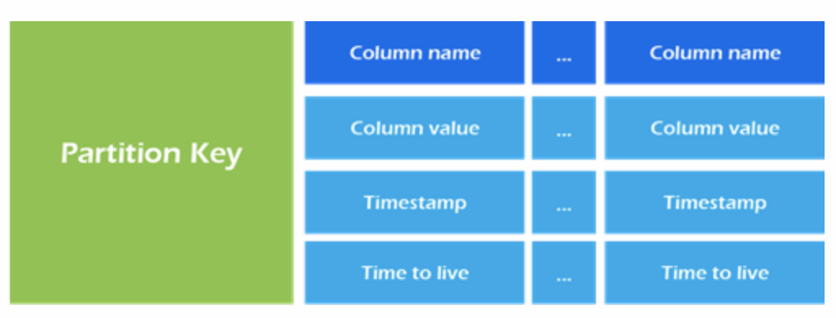
Data Modelling Principles of Cassandra
Forget everything we know about RDB data modelling techniques.
Cassandra data models are maps and not tables.
Using the partition key to access the data in Cassandra.
Structure of each row
Notes:
Data modelling design in Cassandra is very different from the relational databases.
good data modelling design in Cassandra is to forget everything we know about relational database data modelling techniques.
Although in Cassandra we use similar terminologies such as tables, columns and rows. Cassandra data models are maps and not tables.

Slide 9
Cassandra’s Key Concepts
Notes:
Show Student and their details
Show latest courses / suggestion

Slide 10
Cassandra’s Key Concepts:
1. Partition Key (Primary Key) : The WHERE Clause, GROUPING results
2. Clustering Column - ORDERING results
Partition Key
Clustering Column
Notes:
In Cassandra the data is divided into different partitions and then distributed across the nodes for scalability.
We define which column key will be used to be the partition key during the creation of the CQL table.
You can do that by using the "PRIMARY KEY" statement.
In Cassandra, you can also define clustering columns which can be used if you want to sort your data.

Slide 11
Partition Key : a Single Key
create table product_by_id (
id text,
name text,
price decimal,
color text,
PRIMARY KEY( id)
);
Retrieve all products within partition key: id = 1
SELECT * From product_by_id
WHERE id = 1
Partition Key

Slide 12
Partition Key : a Composite Key
//Fail
create table product_by_id_name (
id text,
name text,
price decimal,
color text,
PRIMARY KEY((id,name))
);
SELECT * From product_by_id_name
WHERE id = 1
Retrieve all products within partition key: id = 1 and name = ”product_name”
//Success
SELECT * From product_by_id_name
WHERE id = 1 AND
name = "product_name"
Partition Key
Notes:
using both partition keys columns (id,name)
INSERT INTO product_by_id_name (id, name, price,color) VALUES('P001','pencil XY', 7, 'white’);
INSERT INTO product_by_id_name (id, name, price,color) VALUES('P002','pencil XYZ', 17, 'white');

Slide 13
Clustering Column
create table product_by_release_year_and_size(
id text,
name text,
release_year text,
price decimal,
size text,
PRIMARY KEY((release_year,size), price )
);
Partition Key
Clustering Key
Notes:
using both partition keys columns (id,name)

Slide 14
Clustering Key
Retrieve all products within partition key: release_year = 2015 and size = “large”
//Using clustering key for ordering results
SELECT * FROM product_by_release_Year_and_size
WHERE release_year =2015 AND size = large ORDER BY price DESC LIMIT 50;
//can run parameterized or range queries against the clustering column
SELECT * FROM product_by_release_Year_and_size
WHERE release_year =2015 AND size = large AND price = 1000
SELECT * FROM product_by_release_Year_and_size
WHERE release_year =2015 AND size = large AND price > 1000
Notes:
using both partition keys columns (id,name)
//Fail
Select * from product_by_id_name ORDER BY price DESC; ไม่ได้นะ ต้องมี เงื่อนไขขอ
InvalidRequest: Error from server: code=2200 [Invalid query] message="ORDER BY is only supported when the partition key is restricted by an EQ or an IN."
//OK
Select * from product_by_id_name where id='P001' and name='pencil XY' ORDER BY price DESC;

Slide 15
Data Model Design Rules
Notes:
Show Student and their details
Show latest courses / suggestion

Slide 16
Data Model Design Rules
Design our data model around the query patterns and not around the entities, objects or the relationships that we have.
Absolutely to use denormalization to retrieve our data efficiently and improve performance. Joins aren't supported!!!
Notes:
First rule is that in Cassandra we design our data model around the query patterns and not around the entities, objects or the relationships that we have. This is relatively difficult if you don't know in details all the queries that you need in a new application that you are creating.
The second rule is that it is absolutely to use denormalisation heavily if needed. Writes in Cassandra are cheap and since joins aren't supported, we would need to do a lot of denormalisation to retrieve our data efficiently and improve performance.
Based on the above two design rules, I will show a simple example:

Slide 17
Example: AIT Bookstore Application
Q1) Get a product by id
Q2) Get a category by cat_id
Q3) Get the categories of a particular product
Q4) Get the categories of a particular product

Slide 18
Q1) Get a product by id
Q2) Get category by cat_id
create table product_by_id (
prod_id text,
prod_name text,
price decimal,
color text,
PRIMARY KEY(prod_id)
);
create table category_by_id (
cat_id text,
cat_name text,
PRIMARY KEY(cat_id)
);
P001
prod_name
Pencil XY
price
49
color
White
C001
cat_name
Stationery

Slide 19
Q3) Get all products under a particular category
//denormalize data because joins aren't supported
create table products_by_cat_id (
cat_id text,
prod_id text,
prod_name text,
price decimal,
color text,
PRIMARY KEY(cat_id ,prod_id )
);
C001
Product Details
prod_id | prod_name | price | color
P001 | Pencil XY | 49 | White
P002 | Pen XY | 20 | Red
SELECT *
FROM all_products_by_cat_id
WHERE cat_id = ‘C001’
Notes:
first parameter = partition ket
Patition key = do not duplicate

Slide 20
Q4) Get the categories of a particular product
//denormalize data because joins aren't supported
create table product_by_id
(
prod_id text,
prod_name text,
category set<text>
price decimal,
color text,
PRIMARY KEY(prod_id)
);
P001
category
{stationery}
Product Details
prod_name | price | color
Pencil XY | 49 | White
SELECT category
FROM product_by_id
WHERE prod_id = ‘P001’

Slide 21
Data Manipulation
Notes:
Show Student and their details
Show latest courses / suggestion

Slide 22
Data Manipulation
Cassandra Keyspace Operations
Cassandra Table Operations
Cassandra CRUD Operations
Cassandra CQL Collections

Slide 23
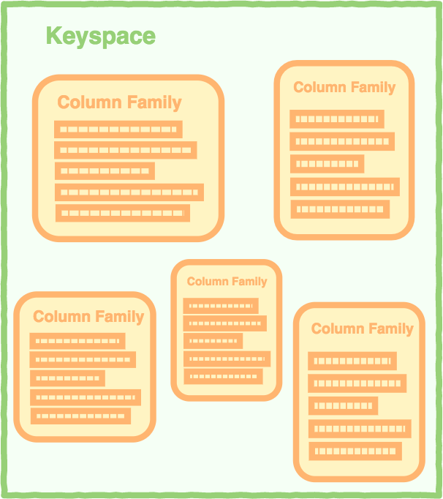
The Structure of a Column Store Database
RDBMS | Cassandra
Database | Keyspace
Table | Column Family/Table
Primary Key | Partition Key
Column Name | Column Name
Column Value | Column Value
A keyspace containing column families.

Slide 24
Cassandra Keyspace Operations
Operations | Syntax
Create | CREATE KEYSPACE <identifier> WITH <properties> i.e. CREATE KEYSPACE test_keyspace WITH replication = {'class': ‘Strategy name’, 'replication_factor' : ‘No.Of replicas’};
Drop | DROP KEYSPACE <identifier> i.e. DROP KEYSPACE test_keyspace
Alter | ALTER KEYSPACE <identifier> WITH <properties> i.e. ALTER KEYSPACE test_keyspace WITH replication = {'class': ‘Strategy name’, 'replication_factor' : ‘No.Of replicas’};
Source: https://www.tutorialspoint.com/cassandra/cassandra_create_keyspace.htm
Notes:
Same as SQL, but with keyspaces and types option added.
The properties of ALTER KEYSPACE are same as CREATE KEYSPACE. It has two properties: replication and durable_writes.
You can used this command to alter properties such as the number of replicas and the durable_writes of a KeySpace. Given below is the syntax of this command.
https://www.tutorialspoint.com/cassandra/cassandra_create_keyspace.htm

Slide 25
Cassandra Keyspace Operations
Create Keyspace
cqlsh> CREATE KEYSPACE test_keyspace WITH replication = {'class': 'SimpleStrategy', 'replication_factor':1} AND durable_writes= 'true’;
View List of Keyspaces
cqlsh> DESCRIBE KEYSPACES;
Use Keyspace
cqlsh> USE test_keyspace;
Drop Keyspace
cqlsh> DROP KEYSPACE test_keyspace;

Slide 26
Cassandra Table Operations
Operations | Syntax
Create Table | CREATE TABLE emp( emp_id int , emp_name text, emp_sal varint , PRIMARY KEY (emp_id));
Show all tables in keyspace | DESCRIBE TABLES
View table structure | DESCRIBE TABLE emp;
Alter Table | Adding a Column ALTER TABLE emp ADD emp_email set<text>; Dropping a Column ALTER TABLE emp DROP emp_email;
Drop Table | DROP TABLE emp

Slide 27
Cassandra Table Operations
Operations | Syntax
Truncate Table | Delete all data in a table TRUNCATE emp
Create Index | CREATE INDEX <identifier> ON <tablename> i.e. CREATE INDEX name ON emp (emp_name);
Drop Index | DROP INDEX name
Notes:
When you truncate a table, all the rows of the table are deleted permanently

Slide 28
Cassandra CRUD Operations
Create Table
CREATE TABLE emp(
emp_id int,
emp_name text,
emp_city text,
emp_sal varint,
PRIMARY KEY (emp_id)
);
Notes:
Cassandra supports sorting using the clustering columns. When you create a table, you can define clustering columns which will be used to sort the data inside each partition in either ascending or descending orders. Then you can easily use the ORDER BY clause with the ASC or DESC options. An example is given blow:
Notice that we used the price column to be the clustering column and defined the default sorting order to be DESC using the "WITH CLUSTERING ORDER BY" clause. If we didn't use the "WITH CLUSTERING ORDER BY", the default order is ascending. Now if we run a query against the product table, we will get the data sorted descendingly by the price in each partition.

Slide 29
Cassandra CRUD Operations
Create Data
> INSERT INTO emp(emp_id, emp_name, emp_city, emp_sal) VALUES(1,'pattama', 'Ayutthaya', 50000);
> INSERT INTO emp(emp_id, emp_name, emp_city, emp_sal) VALUES(2,'kantinee', 'Bangkok', 40000);
> INSERT INTO emp(emp_id, emp_name, emp_city, emp_sal) VALUES(3,'robin', 'Bangkok', 45000);

Slide 30
Cassandra CRUD Operations
Update Data
> UPDATE emp SET emp_sal = 55000 WHERE emp_id = 1;
Delete Data
> DELETE FROM emp WHERE emp_id=3;
Note: For update data, the where_clause is used to select the row to update and must include all columns composing the PRIMARY KEY.
Notes:
CREATE INDEX emp_id_in ON emp(emp_id);

Slide 31
Cassandra CRUD Operations
Query Data
> SELECT * FROM emp;
> SELECT * FROM emp WHERE emp_id = 1;
The WHERE Clause: emp_sal is not a primary key **
> CREATE INDEX emp_sal_idx ON emp(emp_sal);
> SELECT * FROM emp WHERE emp_sal = 45000;
Note:− A WHERE clause can be used only on the columns that are a part of primary key or
have a secondary index on them.

Slide 32
Filtering
Filtering data in Cassandra is done by using the WHERE clause where you can query data either by its partition key, clustering columns or secondary indexed columns.
The WHERE clause supports these conditional operators: CONTAINS, CONTAINS KEY, IN, =, >, >=, <, and <=.
Notes:
Filtering data in Cassandra is done by using the WHERE clause where you can query data either by its partition key, clustering columns or secondary indexed columns.

Slide 33
Aggregation
The data in Cassandra is grouped by the partition key and the clustering columns.
Clustering columns are used to sort the data within the partition.
Choosing the right grouping of your data can impact the read and write performance.
Aggregation: COUNT, MIN, MAX, SUM, AVG

Slide 34
Aggregation: Create new table
CREATE TABLE emp_agg(
emp_id int,
emp_name text,
emp_city text,
emp_sal varint,
PRIMARY KEY (emp_city, emp_sal,emp_id)
) WITH CLUSTERING ORDER BY (emp_sal DESC, emp_id ASC);
Notes:
Cassandra supports sorting using the clustering columns. When you create a table, you can define clustering columns which will be used to sort the data inside each partition in either ascending or descending orders. Then you can easily use the ORDER BY clause with the ASC or DESC options. An example is given blow:
Notice that we used the price column to be the clustering column and defined the default sorting order to be DESC using the "WITH CLUSTERING ORDER BY" clause. If we didn't use the "WITH CLUSTERING ORDER BY", the default order is ascending. Now if we run a query against the product table, we will get the data sorted descendingly by the price in each partition.

Slide 35
Aggregation: Create new table
Primary Key
emp_city
The WHERE Clause
GROUPING results
Clustering Column
emp_sal
ORDERING results
emp_id

Slide 36
Aggregation: Create data
> INSERT INTO emp_agg(emp_id, emp_name, emp_city, emp_sal) VALUES(1,'pattama', 'Ayutthaya', 50000);
> INSERT INTO emp_agg(emp_id, emp_name, emp_city, emp_sal) VALUES(2,'kantinee', 'Bangkok', 40000);
> INSERT INTO emp_agg(emp_id, emp_name, emp_city, emp_sal) VALUES(3,'robin', 'Bangkok', 45000);

Slide 37

Aggregation: COUNT
Count: used to count the rows returned by a query
> SELECT COUNT(*),emp_city FROM emp_agg GROUP BY emp_city;
Notes:
The data in Cassandra is grouped by the partition key and the clustering columns. The partition key can be simple (single column) or composite (multiple columns). Clustering columns are used to sort the data within the partition.

Slide 38

Aggregation: MAX and MIN
Max and Min: used to compute the maximum and the minimum value returned by a query for a given column
> SELECT MAX(emp_sal), emp_city FROM emp_agg GROUP BY emp_city;

Slide 39
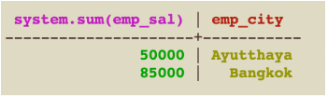
Aggregation: SUM
Sum: used to sum up all the values returned by a query for a given column.
> SELECT SUM(emp_sal), emp_city FROM emp_agg GROUP BY emp_city;

Slide 40
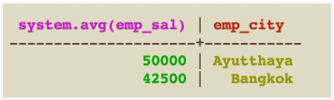
Aggregation: AVG
AVG: used to compute the average of all the values returned by a query for a given column.
> SELECT AVG(emp_sal),emp_city FROM emp_agg GROUP BY emp_city;

Slide 41
Cassandra CQL Collections
SET
A set is a sorted collection of unique values.
LIST
A list is a sorted collection of non-unique values where
elements are ordered by there position in the list.
MAP
A map is a collection of key-value pairs.
Source: https://www.tutorialspoint.com/cassandra/cassandra_cql_collections.htm
Notes:
Cassandra Query Language also provides a collection data types that are used to handle tasks.
The following table provides a list of Collections available in CQL.
CQL provides three different types of collection data types, SET, LIST, MAP.
Using collection data types, you can store multiple values in a single column.

Slide 42
Cassandra CQL Collections
SET
A set is a sorted collection of unique values.
Example:
StudentID | Name | Email
st120100 | Peter | { ‘st120100@ait.asia’ }
st120101 | Anne | { ‘st120101@ait.asia’ }
st120102 | Joe | { ‘joe@gmail.com’, ‘st120102@ait.asia’ }
Notes:
A Set stores group of elements that returns sorted elements when querying.
While inserting data into the elements in a set, enter all the values separated by comma within curly braces { }

Slide 43
Cassandra CQL Collections
SET
A set is a sorted collection of unique values.
Example: Creates a sample table with 3 columns including student_id, name and multiple e-mail accounts.
> CREATE TABLE student(student_id text, name text, email set<text>, PRIMARY KEY (student_id));
Inserting data into a Set - insert name and phone into a table.
> INSERT INTO student(student_id,name, email) VALUES ('st120102', 'Joe', {'joe@gmail.com'});
Updating a Set - adding and deleting another phone number to the set as following commands.
> UPDATE student SET email = email + {'st120102@ait.asia'} where student_id = 'st120102';
> UPDATE student SET email = email - {'st120102@ait.asia'} where student_id = 'st120102';
Notes:
Set is a data type that is used to store a group of elements. The elements of a set will be returned in a sorted order.

Slide 44
Cassandra CQL Collections
LIST
A list is a sorted collection of non-unique values where
elements are ordered by there position in the list.
Example:
StudentID | Name | Email | Enrolled Courses
st120100 | Peter | { ‘st120100@ait.asia’ } | [ ‘DMM101']
st120101 | Anne | { ‘st120101@ait.asia’ } | [ ‘DMM101']
st120102 | Joe | { ‘joe@gmail.com’, ‘st120102@ait.asia’ } | [‘DMM101’, ‘ML101']
Notes:
Using these Collection types, you can store multiple values in a single variable.
List is used in the cases where
the order of the elements is to be maintained, and
a value is to be stored multiple times.
You can get the values of a list data type using the index of the elements in the list.

Slide 45
Cassandra CQL Collections
LIST
A list is a sorted collection of non-unique values where
elements are ordered by there position in the list.
Example: Alter a sample table with adding column to store enrolled courses of a student.
> ALTER TABLE student ADD enrolled_courses list<text> ;
Updating a List - adding and deleting enrolled course to the list as following commands.
> UPDATE student SET enrolled_courses = enrolled_courses + ['DMM101','ML101'] where student_id = 'st120102';
> UPDATE student SET enrolled_courses = enrolled_courses – ['ML101'] where student_id = 'st120102';
Notes:
ALTER TABLE emp ADD emp_email set<text>;

Slide 46
Cassandra CQL Collections
MAP
A map is a collection of key-value pairs.
Example:
StudentID | Name | Email | Enrolled Courses | Address
st120100 | Peter | { ‘st120100@ait.asia’ } | [ ‘DMM101’ ] | {‘room_no’ : ‘101’ , ‘dorm’: ‘Dorm A’ }
st120101 | Anne | { ‘st120101@ait.asia’ } | [ ‘DMM101’ ] | {‘room_no’ : ‘102’ , ‘dorm’: ‘Dorm B’ }
st120102 | Joe | { ‘joe@gmail.com’, ‘st120102@ait.asia’ } | [ ‘DMM101’, ‘ML101’ ] | {‘room_no’ : ‘103’ , ‘dorm’: ‘Dorm C’ }
Notes:
Using these Collection types, you can store multiple values in a single variable.
List is used in the cases where
the order of the elements is to be maintained, and
a value is to be stored multiple times.
You can get the values of a list data type using the index of the elements in the list.

Slide 47
Cassandra CQL Collections
MAP
A map is a collection of key-value pairs.
Example: Alter a sample table with adding column to store an address of a student.
> ALTER TABLE student ADD address map<text, text> ;
Updating a List - adding and deleting enrolled course to the list as following commands.
> UPDATE student SET address = address + {'room_no':'101', 'dorm': 'Dorm C', 'room_type':'single room'} where student_id = 'st120102';
> UPDATE student SET address['room_type'] = 'single room & air condition' where student_id = 'st120102';
> UPDATE student SET address = address – {'room_type'} where student_id = 'st120102';
Notes:
ALTER TABLE emp ADD emp_email set<text>;
ข้อห้าม
https://www.guru99.com/cassandra-query-language-cql-insert-update-delete-read-data.html

Slide 48
Cassandra CQL Collections
Example: Query Data in A Map
> CREATE INDEX address_idx ON student(address);
//address of students which has value contains 'Dorm C
> SELECT * FROM student WHERE address CONTAINS 'Dorm C';
//query address of students with specific column
> SELECT * FROM student WHERE address['dorm'] = 'Dorm C' ALLOW FILTERING;
Notes:
https://cassandra.apache.org/doc/latest/cql/dml.html
//query data in map value without specific key of map
InvalidRequest: Error from server: code=2200 [Invalid query] message="Cannot execute this query as it might involve data filtering and thus may have unpredictable performance. If you want to execute this query despite the performance unpredictability, use ALLOW FILTERING"
cqlsh:test_keyspace> SELECT * FROM student WHERE location['dorm'] = 'Dorm C' ALLOW FILTERING;

Slide 49
References
Download and Installation : http://cassandra.apache.org/doc/latest/getting_started/installing.html
Cassandra Tutorial: https://www.javatpoint.com/cassandra-tutorial
Data manipulation: http://cassandra.apache.org/doc/latest/cql/dml.html
When to use Cassandra :https://towardsdatascience.com/when-to-use-cassandra-and-when-to-steer-clear-72b7f2cede76
https://www.sudoinit5.com/post/spring-data-cassandra-data-modeling/
https://dba.stackexchange.com/questions/55165/cassandra-query-a-column-with-collection-type
https://www.datastax.com/blog/2012/08/coming-12-collections-support-cql3

Slide 50
References
Designing a Cassandra Model: https://shermandigital.com/blog/designing-a-cassandra-data-model/
Difference between partition key, composite key and clustering key in Cassandra?: https://stackoverflow.com/questions/24949676/difference-between-partition-key-composite-key-and-clustering-key-in-cassandra#targetText=The%20Partition%20Key%20is%20responsible,Simple).
Cassandra Data Modeling Best Practices: https://tech.ebayinc.com/engineering/cassandra-data-modeling-best-practices-part-1/
http://alronz.github.io/Factors-Influencing-NoSQL-Adoption/site/Cassandra/Cassandra/

Slide 51

Thank you.

